Slide 1
Markets As a Forecasting Tool
Yiling Chen
School of Engineering and Applied Sciences
Harvard University
Based on work with Lance Fortnow, Sharad Goel, Nicolas Lambert, David Pennock, and Jenn Wortman Vaughan.

Slide 2
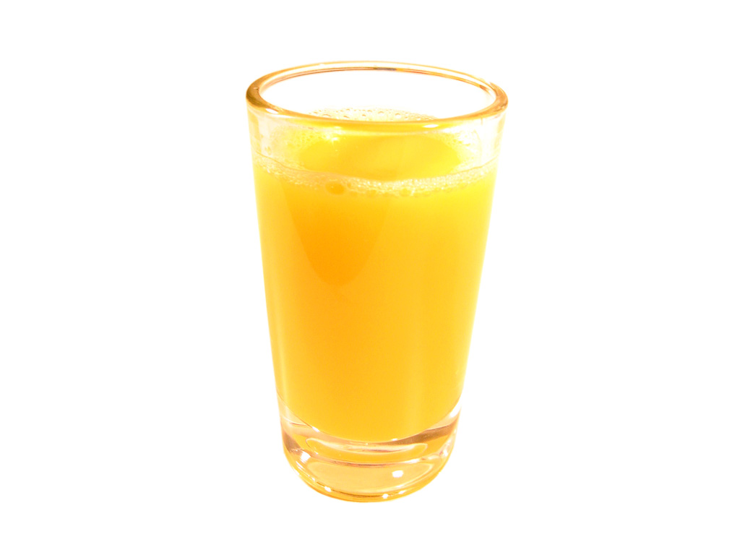
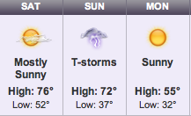
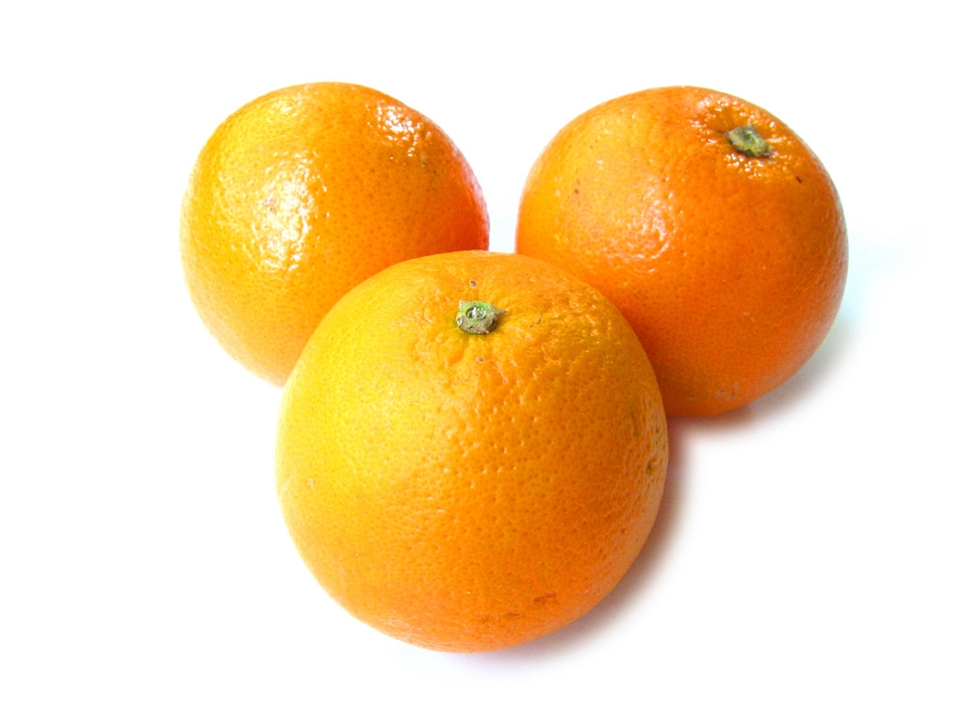
Orange Juice Futures and Weather
Trades of 15,000 pounds of orange juice solid in March
Orange juice futures price can improve weather forecast! [Roll 1984]
Notes:
98% of concentrated orange juice in US is from central Florida region.
75 pounds of oranges per person per year in 2000

Slide 3
Roadmap
Introduction to Prediction Markets
Prediction Market Design
  Logarithmic Market Scoring Rule (LMSR)
  Combinatorial Prediction Markets
LMSR and Weighted Majority Algorithm

Slide 4
Events of Interest
Will category 3 (or higher) hurricane make landfall in Florida in 2011?
Will Google reinstate its Chinese search engine?
Will Democratic party win the Presidential election?
Will Microsoft stock price exceed $30?
Will there be a cure for cancer by 2015?
Will sales revenue exceed $200k in April?
……

Slide 5
The Prediction Problem
An uncertain event to be predicted
  Q: Will category 3 (or higher) hurricane make landfall in Florida in 2011?
Dispersed information/evidence
  Residents of Florida, meteorologists, ocean scientists…
Goal: Generate a prediction that is based on information from all sources

Slide 6
Bet = Credible Opinion
Q: Will Vinay Deolalikar’s proof of P≠NP be validated?
Scott Aaronson: “I have a way of stating my prediction that no reasonable person could hold against me: I’ve literally bet my house on it.”
Betting intermediaries
  Las Vegas, Wall Street, IEM, Intrade,...
Info
Info
I bet $200,000 that the proof is incorrect.
The proof is correct.
Notes:
Both a prediction and a bet are based on one’s information. What we really care about is the information. We want mechanisms that help us get the information.
Vinay Deolalikar’s proof
Scott Arronson’s bet on it.

Slide 7
Prediction Markets
A prediction market is a financial market that is designed for information aggregation and prediction.
Payoffs of the traded contract is associated with outcomes of future events.
$1×Percentage of Vote Share That Obama Wins
$f(x)
$1 Cancer is cured
$0 Otherwise
$1 Obama wins
$0 Otherwise

Slide 8
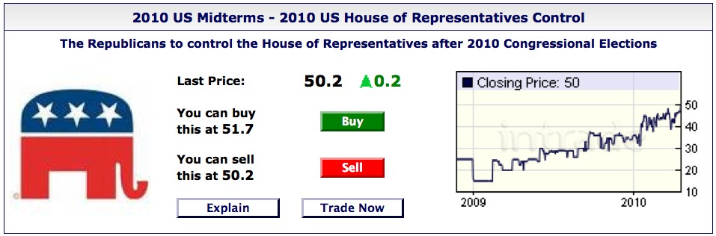
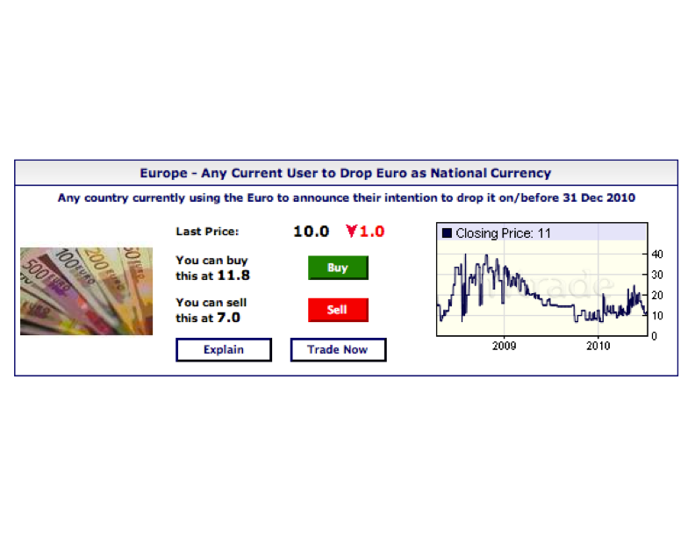
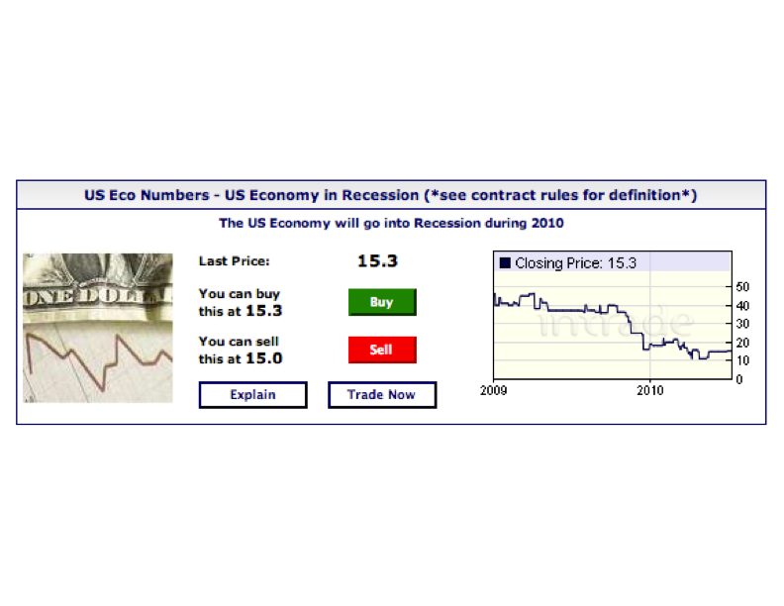
Example: intrade.com

Slide 9
Does it work?
Yes, evidence from real markets, laboratory experiments, and theory
  Racetrack odds beat track experts [Figlewski 1979]
  I.E.M. beat political polls 451/596 [Forsythe 1992, 1999][Oliven 1995][Rietz 1998][Berg 2001][Pennock 2002]
  HP market beat sales forecast 6/8 [Plott 2000]
  Sports betting markets provide accurate forecasts of game outcomes [Gandar 1998][Thaler 1988][Debnath EC’03][Schmidt 2002]
  Market games work [Servan-Schreiber 2004][Pennock 2001]
  Laboratory experiments confirm information aggregation
  [Plott 1982;1988;1997][Forsythe 1990][Chen, EC’01]
  Theory: “rational expectations” [Grossman 1981][Lucas 1972]
  More …

Slide 10
Why Markets? – Get Information
Speculation ➔ price discovery
price ≈ expectation of r.v. | all information
$1 if Patriots win, $0 otherwise
Event Outcome
Value of Contract
Payoff
P( Patriots win )
$1
Patriots win
?
$P( Patriots win )
1- P( Patriots win )
$0
Patriots lose
Equilibrium Price ≈ Value of Contract ≈ P( Patriots Win )
Market Efficiency
Notes:
New England Patriots v.s. Philadelphia Eagles

Slide 11
Non-Market Alternatives vs. Markets
Opinion poll
  Sampling
  No incentive to be truthful
  Equally weighted information
  Hard to be real-time
Ask Experts
  Identifying experts can be hard
  Combining opinions can be difficult
Prediction Markets
  Self-selection
  Monetary incentive and more
  Money-weighted information
  Real-time
  Self-organizing

Slide 12
Non-Market Alternatives vs. Markets
Machine learning/Statistics
  Historical data
  Past and future are related
  Hard to incorporate recent new information
Prediction Markets
  No need for data
  No assumption on past and future
  Immediately incorporate new information
Caveat: Markets have their own problems too – manipulation, irrational traders, etc.

Slide 13
Roadmap
Introduction to Prediction Markets
Prediction Market Design
  Logarithmic Market Scoring Rule (LMSR)
  Combinatorial Prediction Markets
LMSR and Weighted Majority Algorithm

Slide 14
Some Design Objectives of Prediction Markets
Liquidity
  People can find counterparties to trade whenever they want.
Bounded budget (loss)
  Total loss of the market institution is bounded
Expressiveness
  There are as few constraints as possible on the form of bets that people can use to express their opinions.
Computational tractability
  The process of operating a market should be computationally manageable.

Slide 15
Continuous Double Auction
$1 if Patriots win, $0 otherwise
Buy orders
Sell orders
$0.12
$0.30
$0.09
Price = $0.14
$0.17
$0.15
$0.13

Slide 16
What’s Wrong with CDA?
Thin market problem
  When there are not enough traders, trade may not happen.
No trade theorem [Milgrom & Stokey 1982]
  Why trade? These markets are zero-sum games (negative sum w/ transaction fees)
  For all money earned, there is an equal (greater) amount lost; am I smarter than average?
  Rational risk-neutral traders will never trade
  But trade happens …

Slide 17
Automated Market Makers
A automated market maker is the market institution who sets the prices and is willing to accept orders at the price specified.
Why? Liquidity!
Market makers bear risk. Thus, we desire mechanisms that can bound the loss of market makers.

Slide 18




Logarithmic Market Scoring Rule (LMSR) [Hanson 03, 06]
An automated market maker
Contracts
Price functions
Cost function
Payment

Slide 19
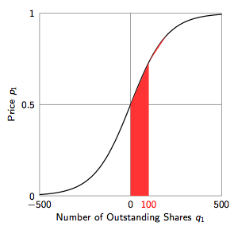
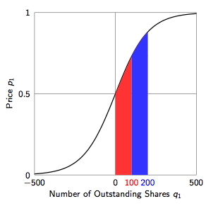
Logarithmic Market Scoring Rule (LMSR) [Hanson 03, 06]
Worst-Case MM loss = b log N

Slide 20
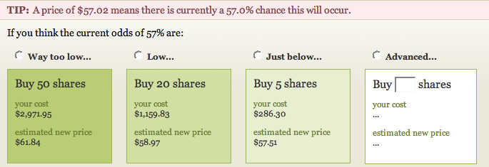

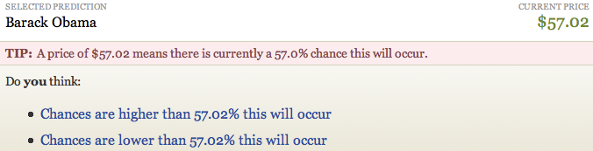
An Interface of LMSR

Slide 21
The Need for Combinatorial
Prediction Market
Events of interest often have a large outcome space
Information may be on a combination of outcomes
Expressiveness
  Expressiveness in getting information
  Expressiveness in processing information

Slide 22
Expressiveness in Getting Information
Things people can express today
  A Democrat wins the election (with probability 0.55)
  No bird ﬂu outbreak in US before 2011
  Microsoft’s stock price is greater than $30 by the end of 2010
  Horse A will win the race
Things people can not express (very well) today
  A Democrat wins the election if he/she wins both Florida and Ohio
  Oil price increases & US Recession in 2011
  Microsoft’s stock price is between $26 and $30 by the end of 2010
  Horse A beats Horse B

Slide 23
Expressiveness in Processing Information
Today’s Independent Markets
  Options at different strike prices
  Horse race win, place, and show betting pools
  Almost every market: Wall Street, Las Vegas, Intrade, ...
Events are logically related, but independent markets let traders to make the inference
What may be better
  Traders focus on expressing their opinions in the way they want
  The mechanism takes care of propagating information across logically related events

Slide 24
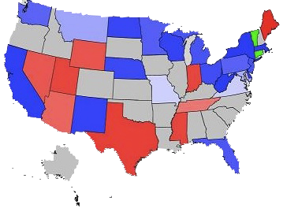
Combinatorics One: Boolean Logic
n Boolean events
Outcomes: all possible 2^{n} combinations of the events
Contracts (created on the ﬂy):
2-clause Boolean betting
  A Democrat wins Florida & not Massachusetts
$1 iff Boolean Formula

Slide 25
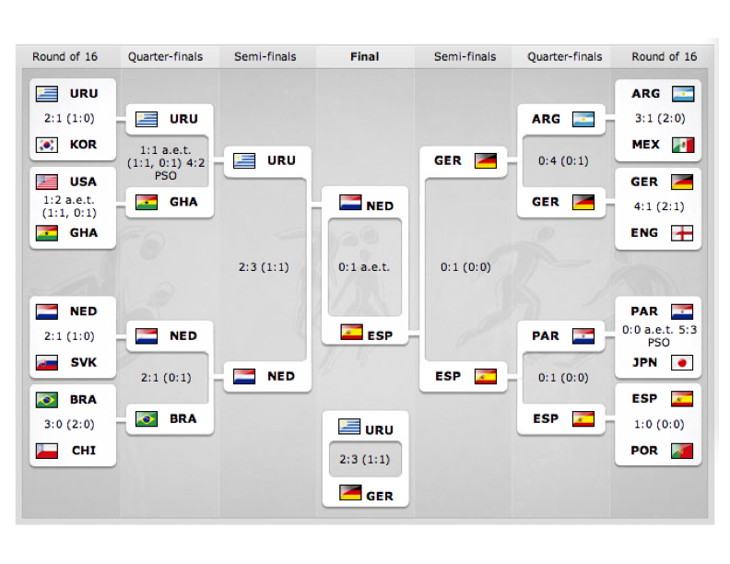
Combinatorics One: Boolean Logic
Restricted tournament betting
  Team A wins in round i
  Team A wins in round i given it reaches round i
  Team A beats teams B given they meet

Slide 26
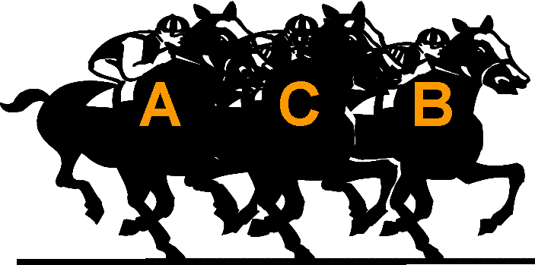
Combinatorics Two: Permutations
n competing candidates
Outcomes: all possible n! rank orderings
Contracts (created on the ﬂy):
Subset betting
  Candidate A ﬁnishes at position 1, 3, or 5
  Candidate A, B, or C ﬁnishes at position 2
Pair betting
  Candidate A beats candidate B
$1 iff Property

Slide 27
Pricing Combinatorial Betting with LMSR
LMSR price function:
It is #P-hard to price 2-clause Boolean betting, subset betting, and pair betting in LMSR. [Chen et. al. 08]
Restricted tournament betting with LMSR can be priced in polynomial time. [Chen, Goel, and Pennock 08]

Slide 28
Roadmap
Introduction to Prediction Markets
Prediction Market Design
  Logarithmic Market Scoring Rule (LMSR)
  Combinatorial Prediction Markets
LMSR and Weighted Majority Algorithm

Slide 29



Learning from Expert Advice
The algorithm maintains weights over N experts
…
w_{1,t}
w_{2,t}
w_{N,t}

Slide 30
Learning from Expert Advice
The algorithm maintains weights over N experts
At each time step t, the algorithm…
  Observes the instantaneous loss l_{i,t} of each expert i
…
w_{1,t}
w_{2,t}
w_{N,t}

Slide 31
Learning from Expert Advice
The algorithm maintains weights over N experts
At each time step t, the algorithm…
  Observes the instantaneous loss l_{i,t} of each expert i
l_{1,t} = 0
l_{2,t} = 1
…
l_{N,t} = 0.5
w_{1,t}
w_{2,t}
w_{N,t}

Slide 32
Learning from Expert Advice
The algorithm maintains weights over N experts
At each time step t, the algorithm…
  Observes the instantaneous loss l_{i,t} of each expert i
  Receives its own instantaneous loss l_{A,t} = Σ_{i} w_{i,t} l_{i,t}
l_{1,t} = 0
l_{2,t} = 1
…
l_{N,t} = 0.5
w_{1,t}
w_{2,t}
w_{N,t}

Slide 33
Learning from Expert Advice
The algorithm maintains weights over N experts
At each time step t, the algorithm…
  Observes the instantaneous loss l_{i,t} of each expert i
  Receives its own instantaneous loss l_{A,t} = Σ_{i} w_{i,t} l_{i,t}
  Selects new weights w_{i,t+1}
l_{1,t} = 0
l_{2,t} = 1
…
l_{N,t} = 0.5
w_{1,t}
w_{2,t}
w_{N,t}

Slide 34
Learning from Expert Advice
The algorithm maintains weights over N experts
At each time step t, the algorithm…
  Observes the instantaneous loss l_{i,t} of each expert i
  Receives its own instantaneous loss l_{A,t} = Σ_{i} w_{i,t} l_{i,t}
  Selects new weights w_{i,t+1}
l_{1,t} = 0
l_{2,t} = 1
…
l_{N,t} = 0.5
w_{1,t+1}
w_{2,t+1}
w_{N,t+1}

Slide 35
Weighted Majority
The classic Randomized Weighted Majority algorithm [Littlestone &Warmuth 94] uses exponential weight updates
Regret = Algorithm’s accumulated loss – loss of the best performing expert < O((T logN)^{1/2})
This equation looks very much like
e^{-ηLi,t}
w_{i,t} =
Σ_{j} e^{-ηLj,t}

Slide 36
Weighted Majority vs. LMSR
Weighted Majority
LMSR
N experts
Maintain weights w_{i,t}
Total loss L_{i,t} = Σ^{t}_{s=1} l_{i,s}
Care about worst-case algorithm regret:
L_{Alg,T} – min_{i} L_{i,T}
N outcomes
Maintain prices p_{i,t}
Total shares sold Q_{i,t} = Σ^{t}_{s=1} q_{i,s}
Care about worst-case market maker loss:
$ received – max_{i} Q_{i,T}
e^{-ηLi,t}
e^{-Qi,t/b}
w_{i,t} =
p_{i,t} =
Σ_{j} e^{-ηLj,t}
Σ_{j} e^{-Qj,t/b}

Slide 37
LMSR Corresponds to Weighted Majority
Given LMSR price functions, can generate the Weighted Majority algorithm with weights
w_{i,t} = p_{i}(q_{j} = -ε L_{j,t})
LMSR learns probability distributions using Weighted Majority by treating observed trades as (negative) losses
Similar relation holds for other market makers and no-regret learning algorithms.
[Chen and Vaughan 2010]

Slide 38
Conclusion
Markets can potentially be a very effective information aggregation and forecasting tool.
New mechanism design challenges.
Markets and machine learning can potentially be close…

