Slide 1
Synchronous Experiments on Mechanical Turk
Winter Mason
Sid Suri

Slide 2
Outline
Fitting a square peg in a round hole
How to use Mechanical Turk for synchronous experiments
The innovation
A study in networked public goods games
The extension
A study on group problem solving

Slide 3
A square peg in a round hole
Running synchronous experiments on Mechanical Turk

Slide 4
Synchronous Experiments
The square peg (Mechanical Turk)
Designed for independent tasks
Work by the crowd is meant to be done in parallel
The round hole (Synchronous Experiments)
Economic games
Social psychology
Group behavior

Slide 5
Key ingredients
Building a Panel
Notifying Workers
A Waiting Room
Managing Attrition

Slide 6
Building a Panel
Run a preliminary study
Qualification HIT, for demographics / training
Unrelated study
Small, pilot experiments (4-8 players)
Waiting time is not too high
Less consequences if there is a bug
Ask if they would like to be notified of future studies
85% opt in rate for SW ‘10
78% opt in rate for MW ‘11

Slide 7
Notifying Workers
Mturk API call that sends an e-mail to workers
Notify them a day early
Experiments work well 11am-5pm EST
If n subjects are needed, notify 3n
So far up to 45 players simultaneously

Slide 8
Waiting Room
Workers need to start a synchronous experiment at the same time
Workers show up at slightly different times
Have workers wait at a page until enough arrive
Show how many they are waiting for
After enough arrive:
Direct players to beginning of experiment
Tell additional players experiment is full
OR funnel extra players into another instance of the waiting room

Slide 9
Attrition
In person, walk-outs are rare
On the web:
Browsers/computers crash
Internet connections go down
Bosses walk in
Need a timeout and a default action
Discard experiments with < 90% human actions
SW ‘10 discarded 21 of 94 experiments with 20-24 people
Discard experiment where one player acted < 50% of the time
MW ‘11 discarded 61 of 232 experiments with 16 people

Slide 10
The innovation
A public goods game over networks

Slide 11
Social Dilemmas in Networks
A social dilemma occurs when the interest of the individual is at odds with the interest of the collective.
In social networking sites one’s contributions are only seen by friends.
E.g. photos in Flickr, status updates in Facebook
More contributions, more engaged group, better for everyone
Why contribute when one can free ride?

Slide 12
Public Goods Games Over Networks
12
Players: nodes in a network G=(V,E), |V|=n
Actions:
each player has endowment e
player p contributes simultaneously with other players
Payoff:
where
Use regular graphs so the marginal rate of return is the same
Similar to Cassar ‘06
Notes:
Define public goods game when everyone is only player with their friends/neighbors.
explain why this is a dilemma:
- contributing one more unit returns a/n to each player, since a/n < 1, the dominant strategy is to contribute 0 - again, since contributing one more unit returns a/n to each player there are n player the overall increase to all players is a > 1
thus to maximize (social welfare) all players contribute e

Slide 13
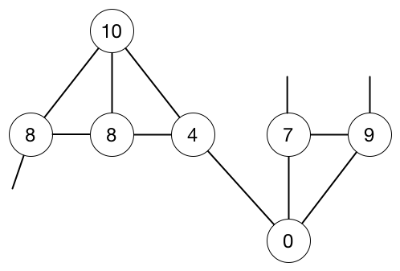
Public Goods Games Over Networks: Example
13
Piece of an example network with contributions and payoffs
Payoff function:

Slide 14
Experimental Parameters
Workers must pass a quiz
Pay $0.50 for passing the quiz plus 1/2 cent per point
10 rounds, 45 sec for first two, 30 sec for the rest
Parameters:
Endowment for each round is 10 points
Marginal rate of return is 0.4 (Fehr & Gachter ’00), regular graphs
Payoff:
n = 4, 6, 8, 24
Some experiments all fresh players, others repeat players
14
Notes:
Give all parameters for the investment game

Slide 15
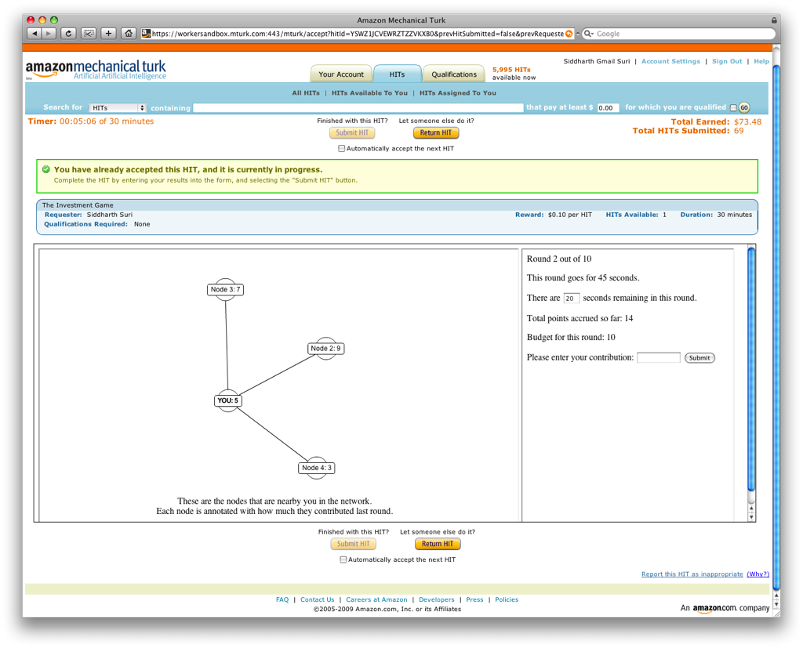
15
Notes:
Before I get to results any questions about format of experiments
skip?

Slide 16
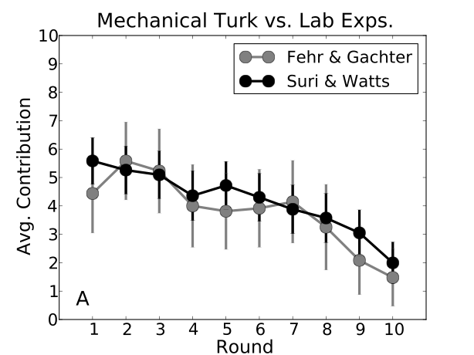
Mechanical Turk vs. Lab
16
Cliques of size 4
allowed repeat players
24 trials
MTurk experiments replicate tightly controlled lab experiments very well
Fehr & Gachter, American Economic Review, 2000
10 trials
Notes:
update the figure above

Slide 17
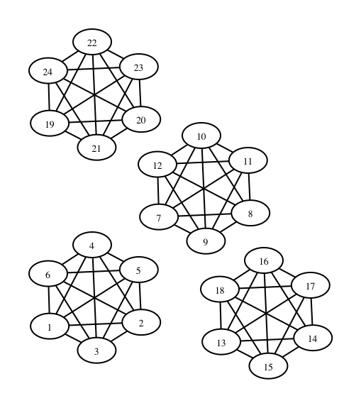
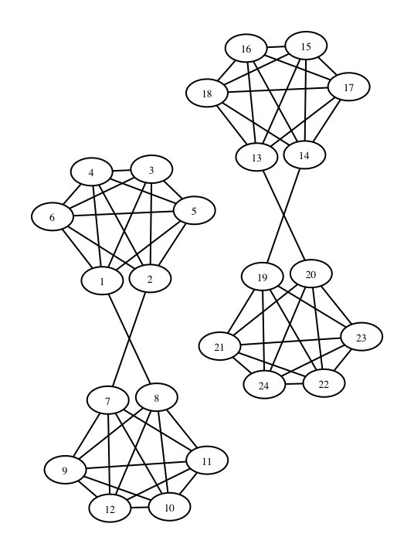
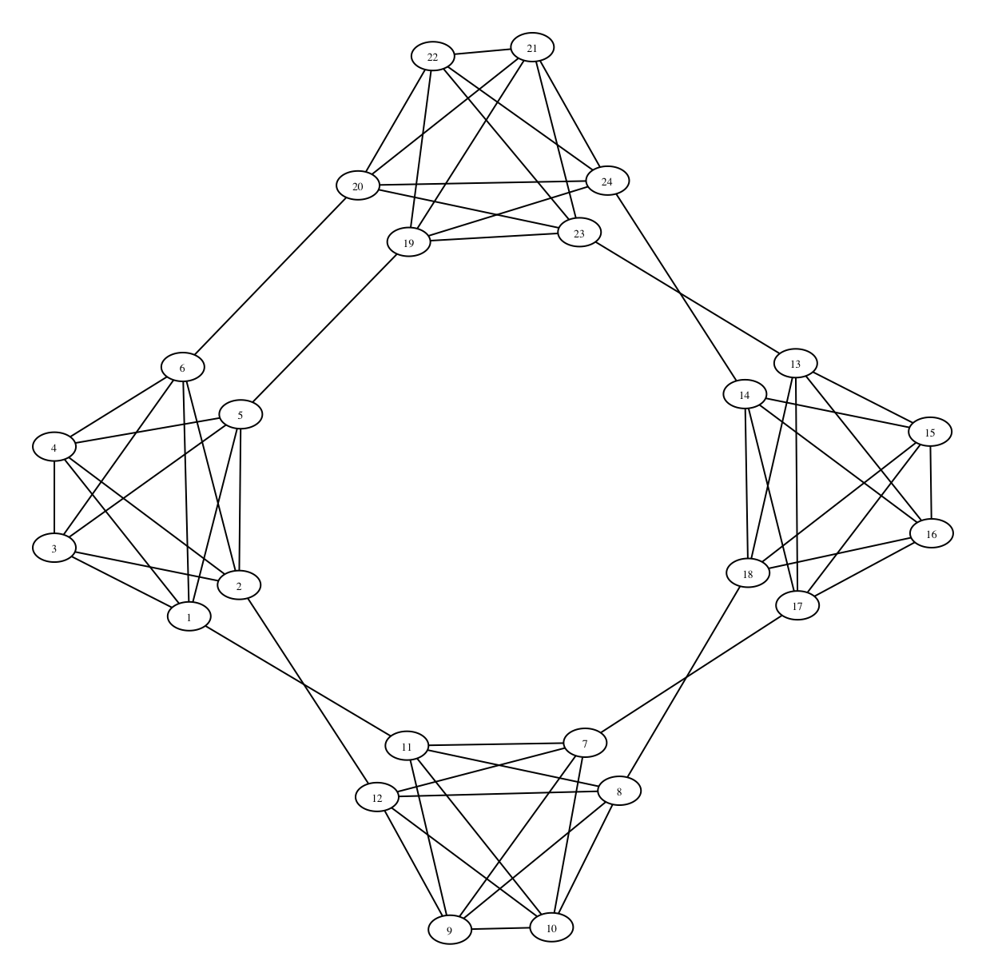
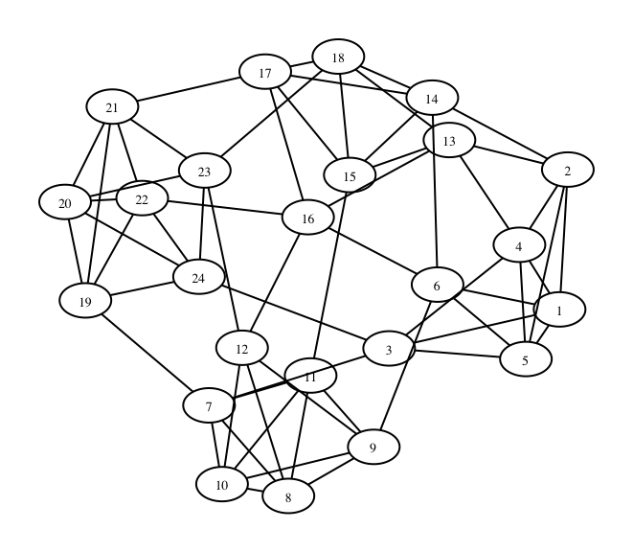
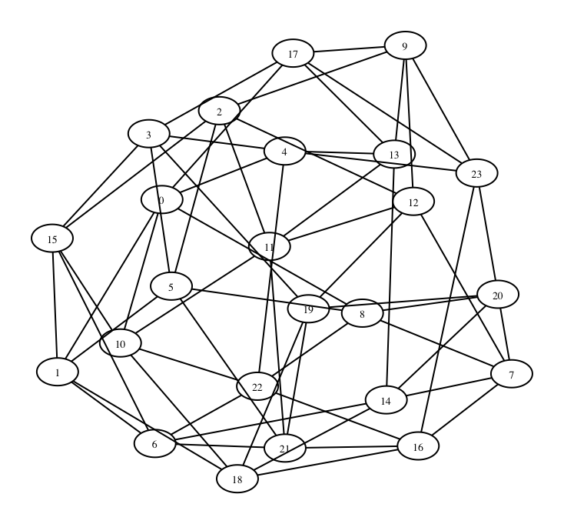
17
Cycle
Cliques
Paired
Cliques
Small
World
Random
Regular
Notes:
cite duncan

Slide 18
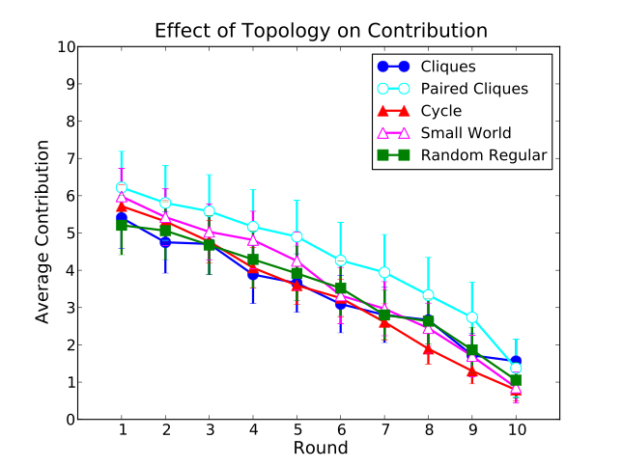
Effects of Topology on Contribution
18
Topology has little to no effect on contribution
especially if you unify starting points
23 trials, n=24
In contrast with coordination games over networks (Kearns et al ‘06, ’09)
Notes:
As you can see contribution levels go down, what can we do to increase contribution levels

Slide 19
Enhancing Contribution
Surveys: Ledyard ‘95, Camerer & Fehr ‘06
Punishment: pay to deduct point from others
Ostrom et al ‘92, Fehr & Gachter ’00 ’02,...
Results in a loss of efficiency but enhances cooperation
Rewards: transfer points to others
with reciprocity enhances cooperation: Rand et al ’09
without reciprocity doesn’t enhance cooperation: Sefton et al ’07,...
Can enhance cooperation if you change the game
artificial seed players that always contribute 10 or 0
19
Notes:
Key point, if you change the game, can get cooperation, we don’t change the game
double check Rand and Sefton bullets

Slide 20
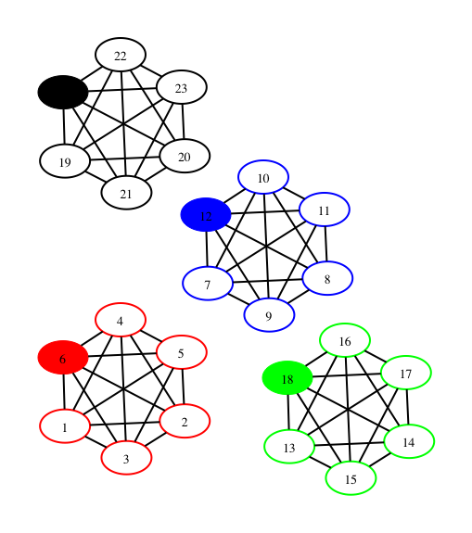
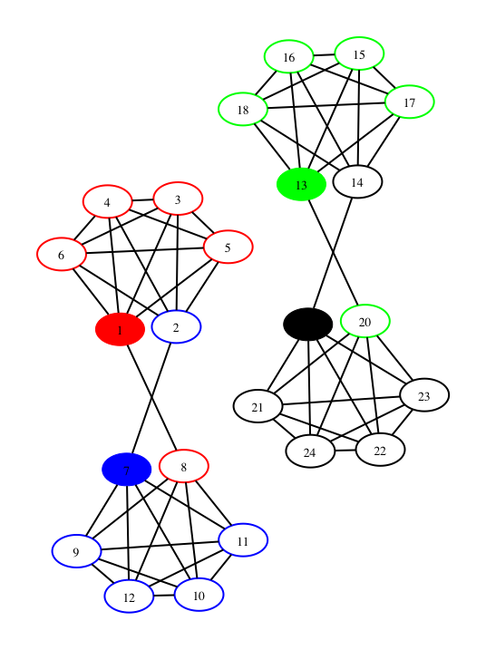
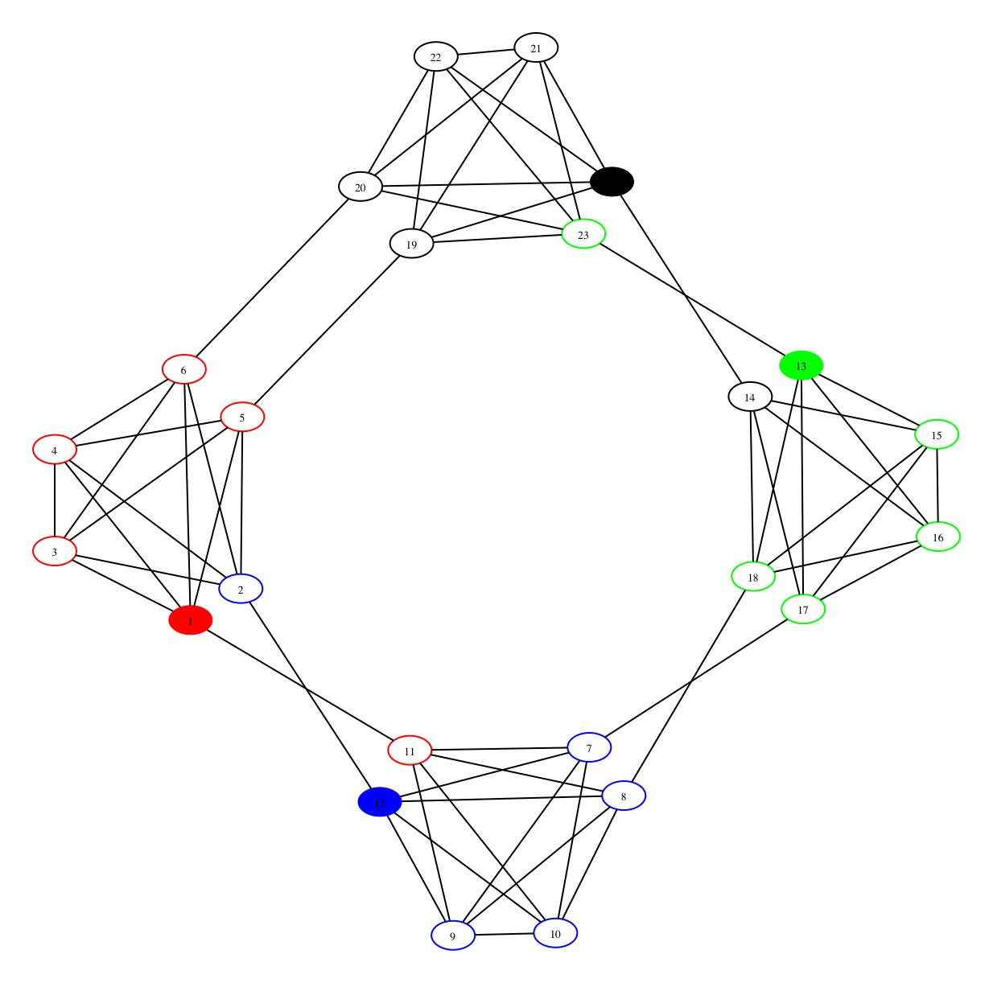
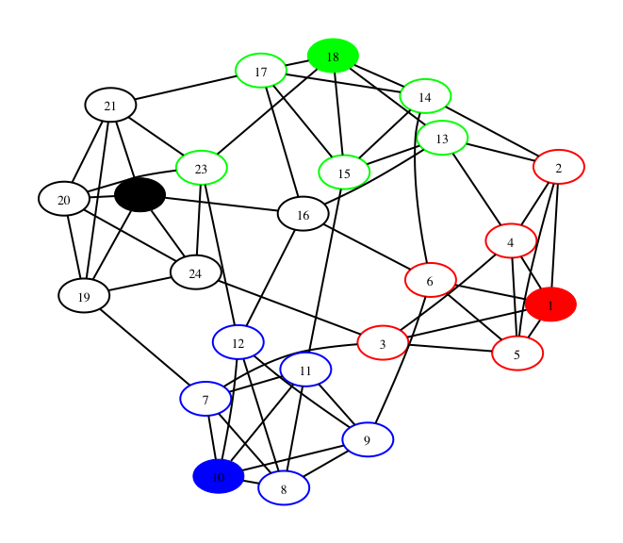
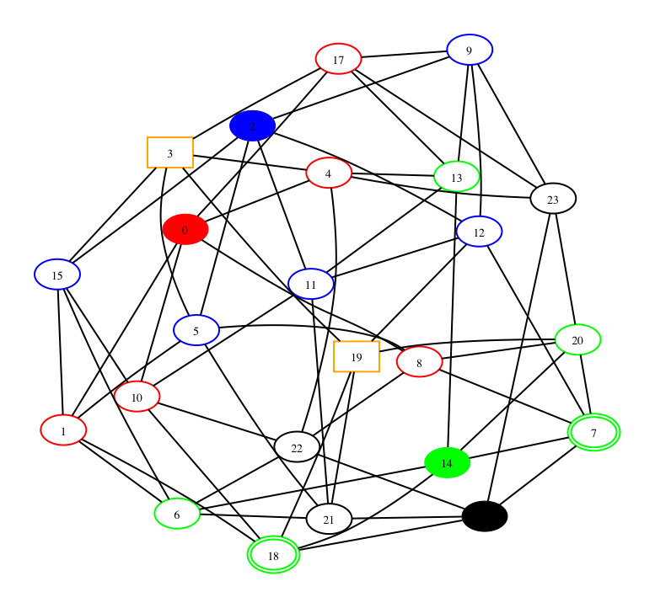
20
Cycle
Cliques
Paired
Cliques
Small
World
Random
Regular
Notes:
Ask students to guess whether they think dummies matter

Slide 21
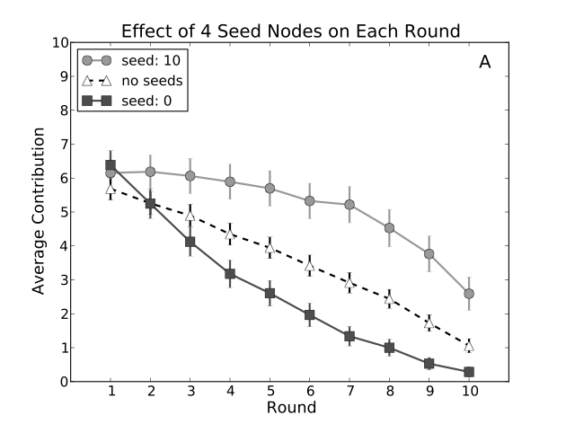
Effect of Seed Nodes
21
10-seeds: 13 trials 0-seeds: 17 trials
Only human contributions are included in averages
People are conditional cooperators
Fischbacher et al. ‘01
Notes:
10-dummies make a concave curve
0-dummies make a convex curve

Slide 22
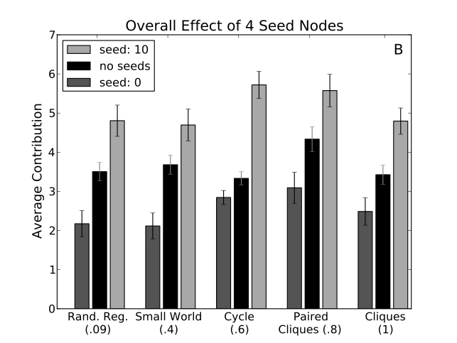
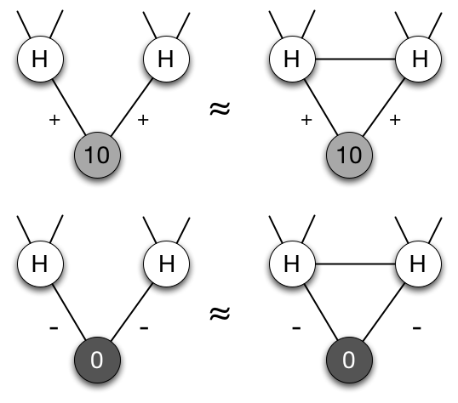
Effect of Seeds on Overall Contribution
22
Effect of seed players is not consistently bigger in networks with higher clustering.
Notes:
Could also put in a table that shows how the average contributions levels vary with clustering coefficient
Could put a slide in after this showing that the the gap between black and blue in 4_k_6 rand and random regular fit the theory from my EC ’06 paper
change color of error bars use most recent plot (also for 4_k_6_cycle)

Slide 23
The extension
A game for studying group problem solving

Slide 24
Collective Problem Solving
Many ways groups collectively solve problems
As a team, with specified roles
As independent agents with information sharing
Competitively, with adversarial information control
In this project, we focus on the second kind
Individuals searching for a solution for their own benefit
Information sharing is incidental or ultimately self-motivated
Most situations in which innovations are shared and built upon

Slide 25
Exploration vs. Exploitation
For this type of collective problem solving, there can be an exploration / exploitation tradeoff
High risk / high payoff strategy of innovating / exploring
Low risk strategy of exploiting best existing solution
Propagation of Innovations in Networked Groups
Depending on problem to be solved, exploration can be more or less useful
Network structure can affect amount of exploration vs. exploitation
Therefore, network structure can affect group success

Slide 26
Overview
Substantive Questions
Does the structure of the communication network between individuals contribute to their collective performance? If so, how?
Does individual position in the network relate to individual performance?
Is there a tradeoff in collective performance and individual performance?
Experimental Approach
Create well-defined networks and payoff functions to precisely identify features that affect individual and group success
Investigate collective problem solving with a game

Slide 27
WildCat Wells
Players “drill” at a spot and get “oil” from the drill
See where 3 other players drilled & how much oil they got
Network is unknown to players
Known maximum points
15 rounds to explore
30 seconds per round
If round is missed, no guess is made, no information is shared
20 points earned = $0.01

Slide 29
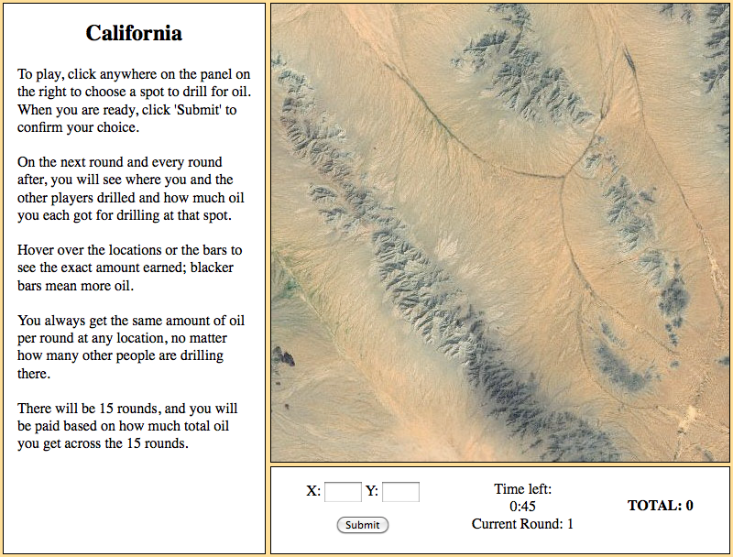

Slide 30
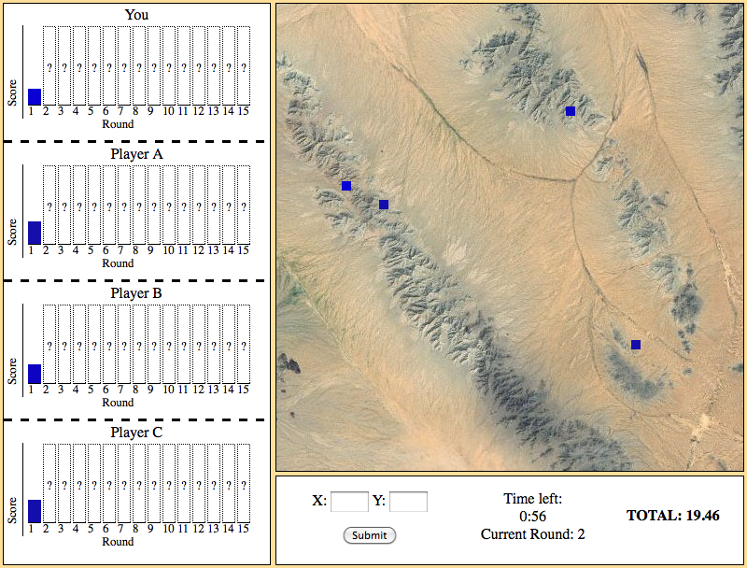

Slide 31
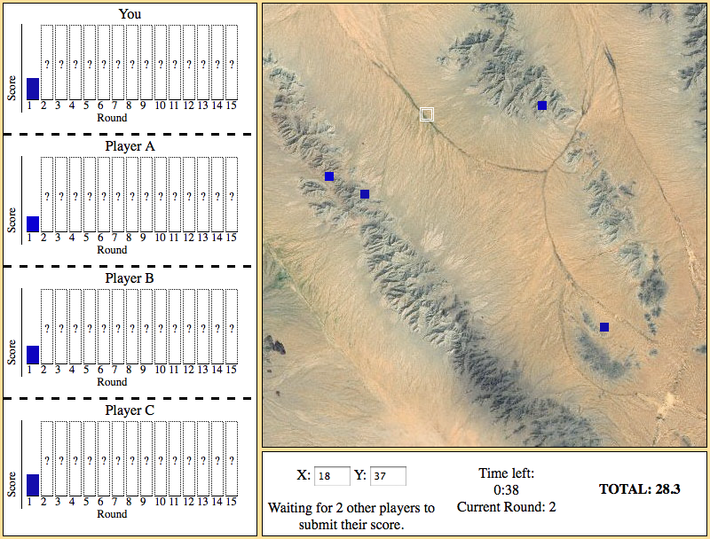

Slide 32
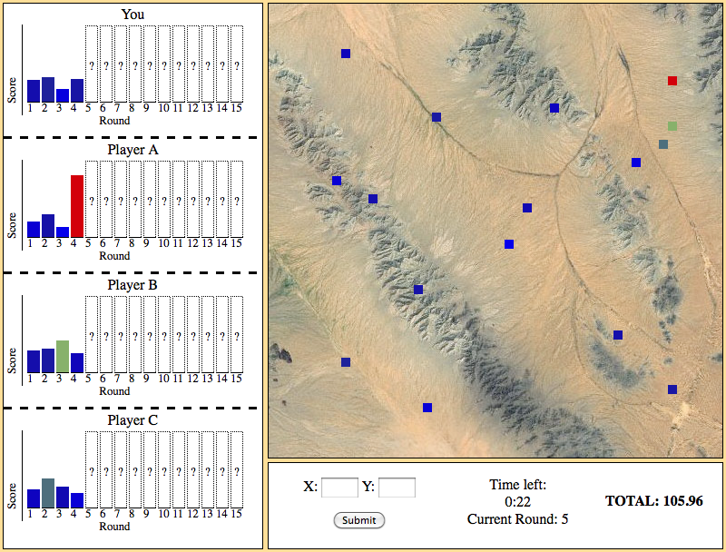

Slide 33
Payoff Functions
Background generated with 4-octave Perlin noise
Added to a unimodal Gaussian function with mean chosen uniformly at random and SD = 3
Normalized so maximum points = 100

Slide 34
Constructing Communication Networks
Goal: 16-node fixed-degree graphs with extreme statistics
Start with fixed-degree random graphs
All players have same amount of information
Only position in graph can affect success
Rewire to increase or decrease some graph feature
Maximum, Average, Variance
Betweenness, Closeness, Clustering, Network Constraint
Ensuring connected graph
Stop when no rewiring improves feature
Repeat 100 times, keep maximal graph

Slide 35
Features
Clustering:
Number of connected neighbors / Possibly connected neighbors
Betweenness
Number of shortest paths through node
Closeness
Average shortest path to all nodes
Network Constraint
Redundancy with neighbors

Slide 36
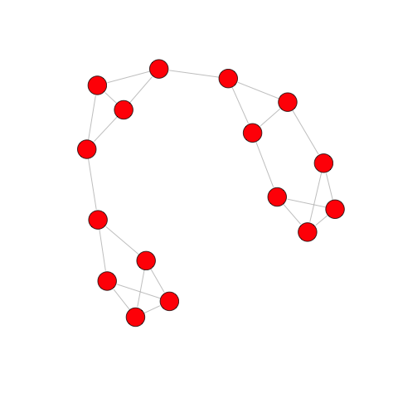
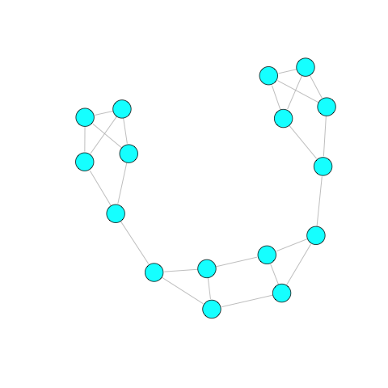
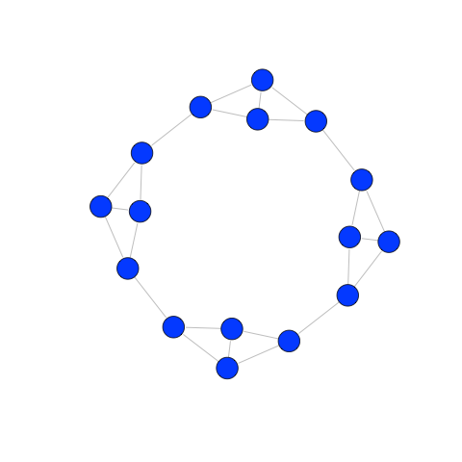
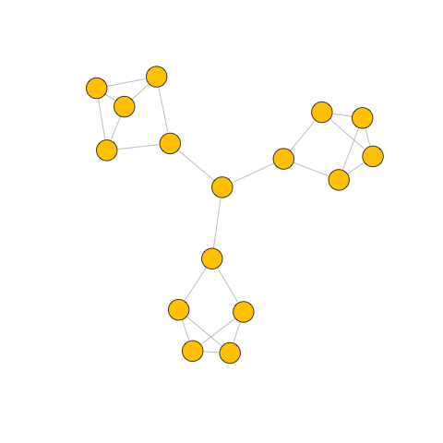
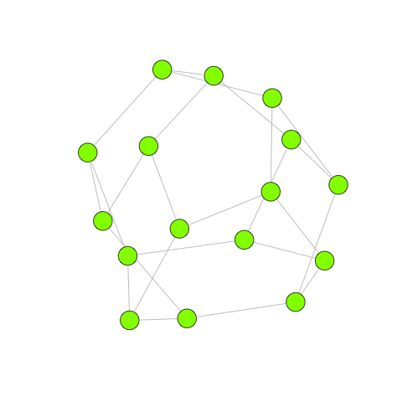
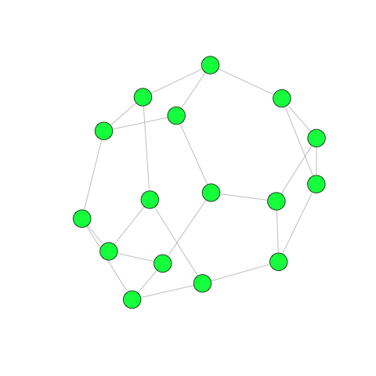
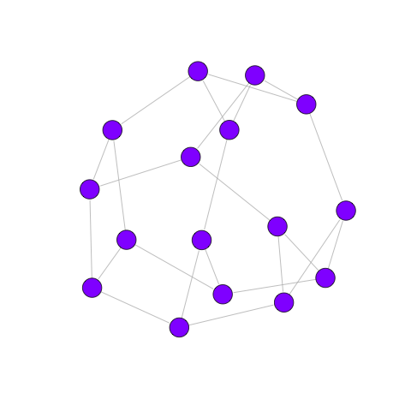
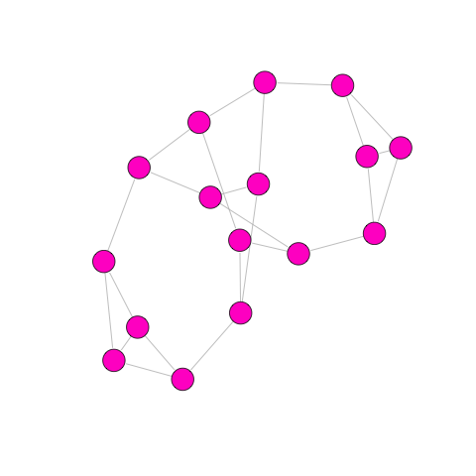
Communication Networks
Greatest Average Betweenness
Smallest Maximum Closeness
Greatest Average Clustering
Greatest Maximum Betweenness
Smallest Average Betweenness
Greatest Maximum Closeness
Smallest Average Clustering
Greatest Variance in Constraint

Slide 37
Experiments
For each session, 16 subjects are recruited from MTurk
Standing panel alerted previous day
Accept work & read instructions
Sit in “waiting room” until enough players have joined
Each session comprises 8 games
One for each network topology
Each game runs for 15 rounds
100 x100 grid
Relative dimensions of peak and landscape adjusted such that peak is found sometimes, but not always
171 out of total of 232 games (25 sessions) used
61 games removed because player dropped out
Notes:
Note mturk methods paper here

Slide 38
Key Results
Network structure does not affect how quickly members find the best solution
Network structure does affect how quickly members converge on the solution, and therefore the success of the group
Position in the network affects individual success, but not as much as network as a whole
Players may experience a social dilemma in exploration / exploitation strategy

Slide 39
Finding & converging on peak
In 107 of the 171 games (62.6%), at least one player “found the peak” (guessed within 4 units of distance from the maximum)
In 96 of these all players converged on the peak (i.e., every player “found the peak”)
For each game,
if the peak was not found a player earned 598 pts (~$0.30) on average
If the peak was found a player earned 1022 pts (~$0.51) on average

Slide 40
Network Structure Doesn’t Affect Whether or When the Maximum is Found

Slide 41
Networks Affect Convergence Time
Main difference seems to be between networks with some kind of structure vs. approximately random networks
Differences in average path length could explain differences in success

Slide 42
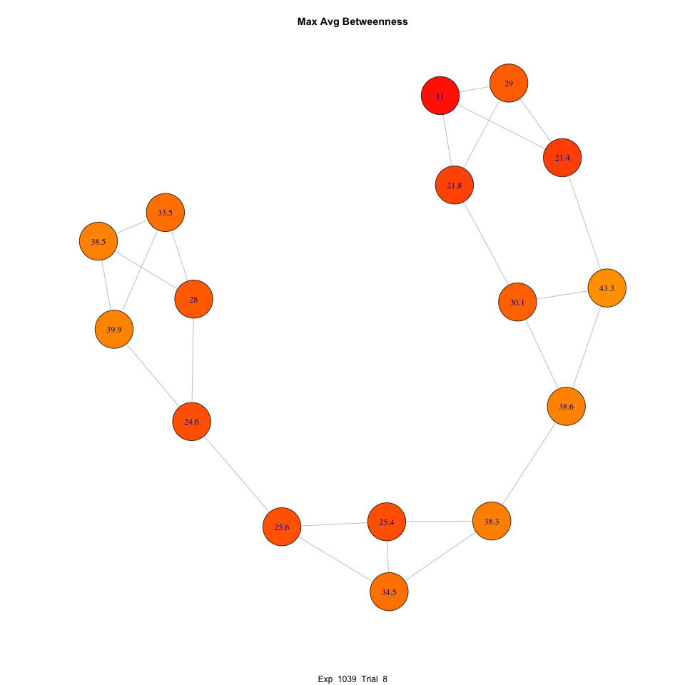
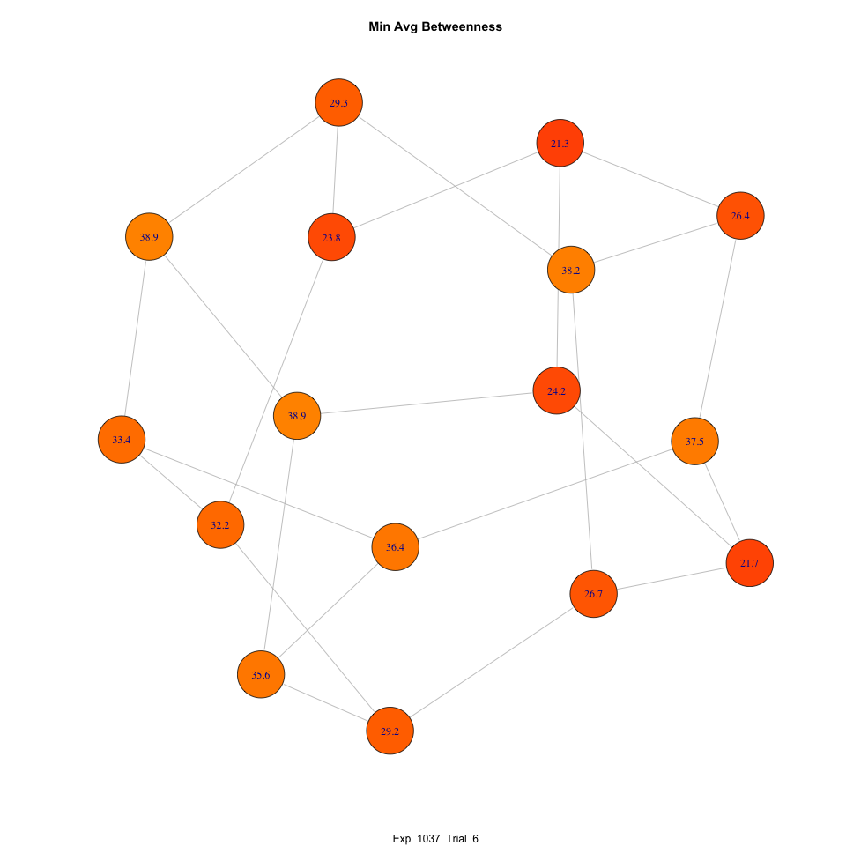
Diffusion of Best Solution

Slide 43
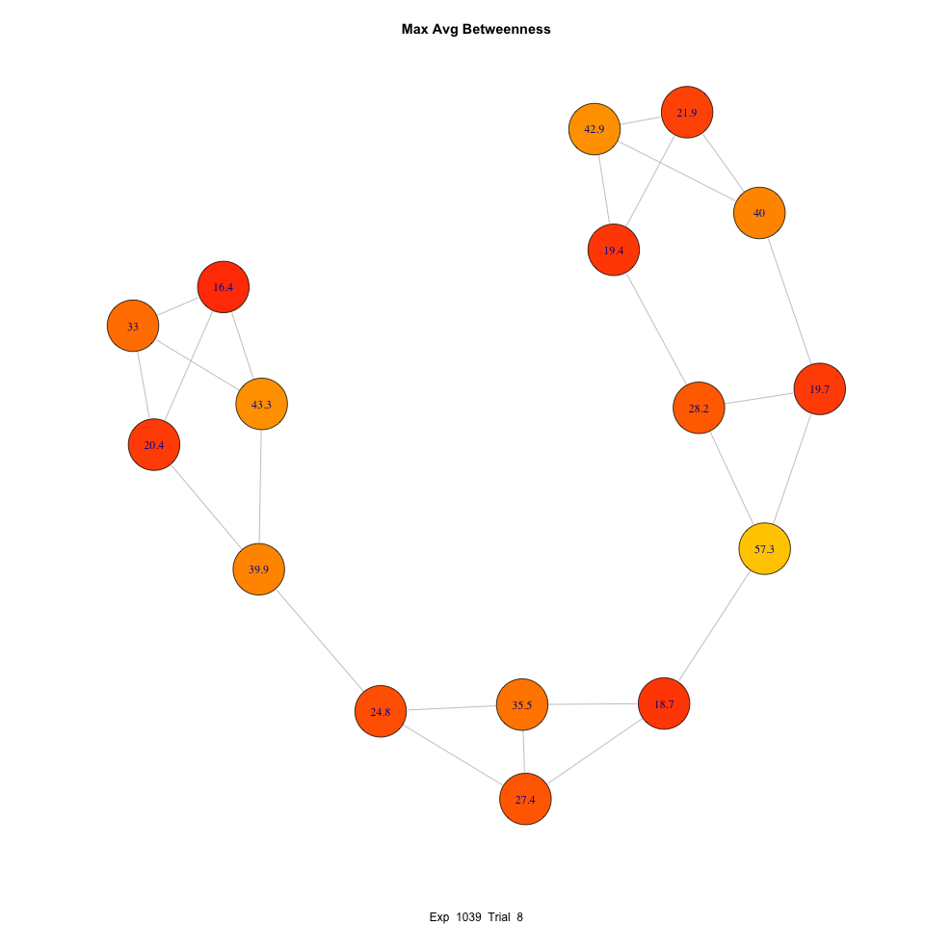
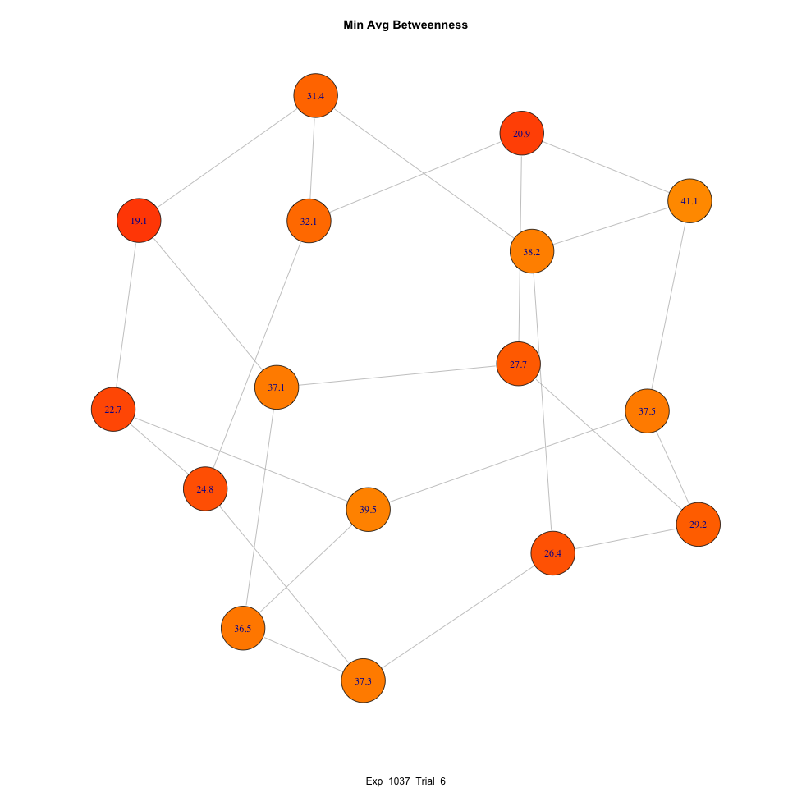
Diffusion of Best Solution

Slide 44
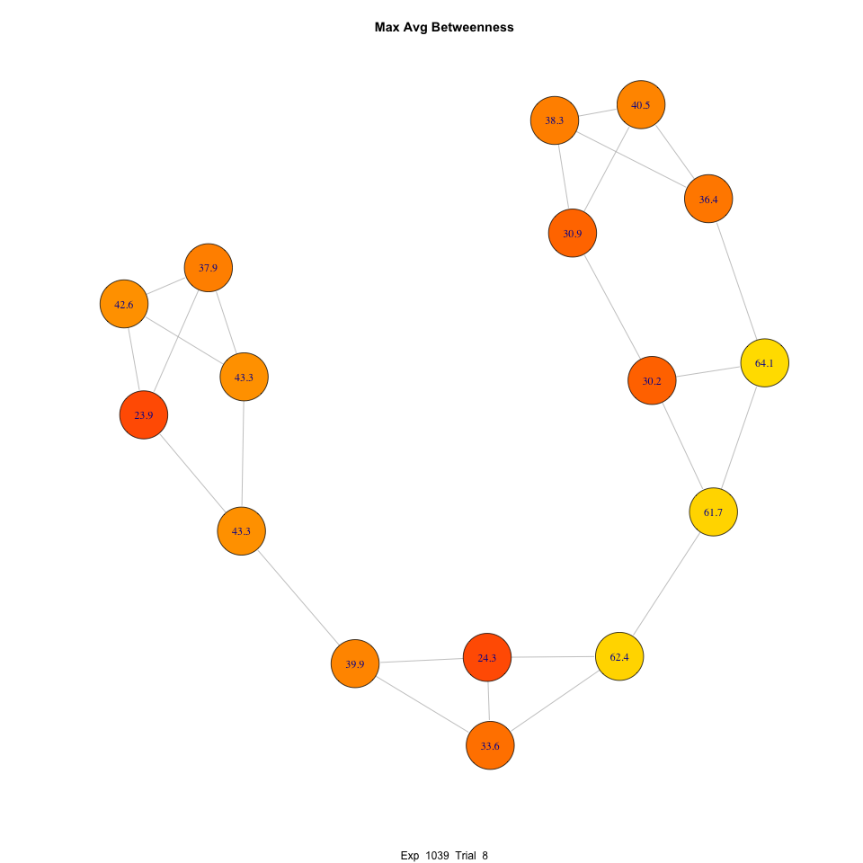
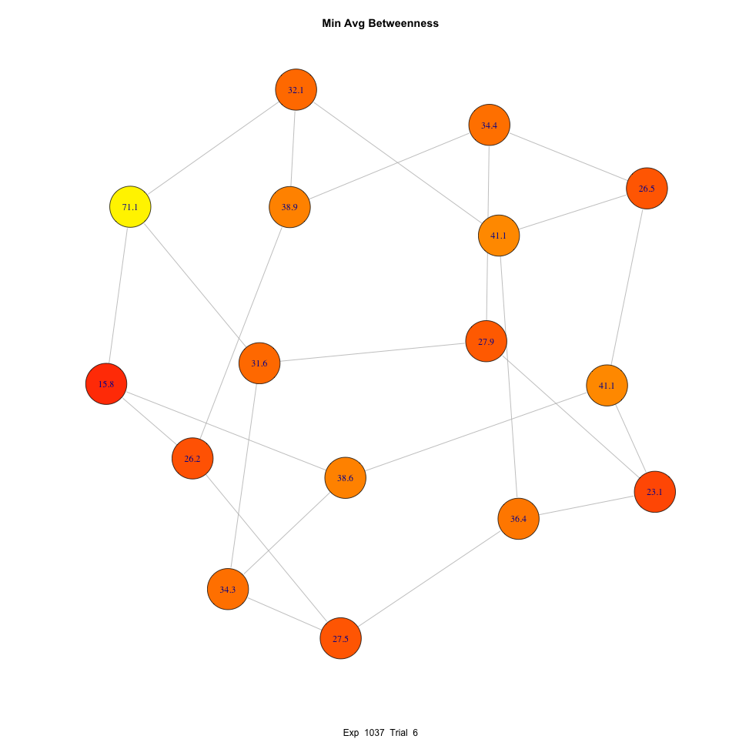
Diffusion of Best Solution

Slide 45
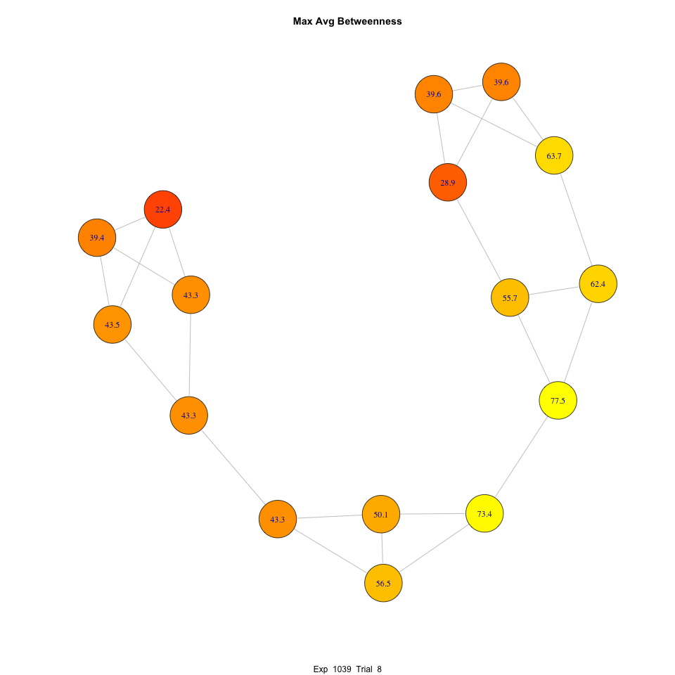
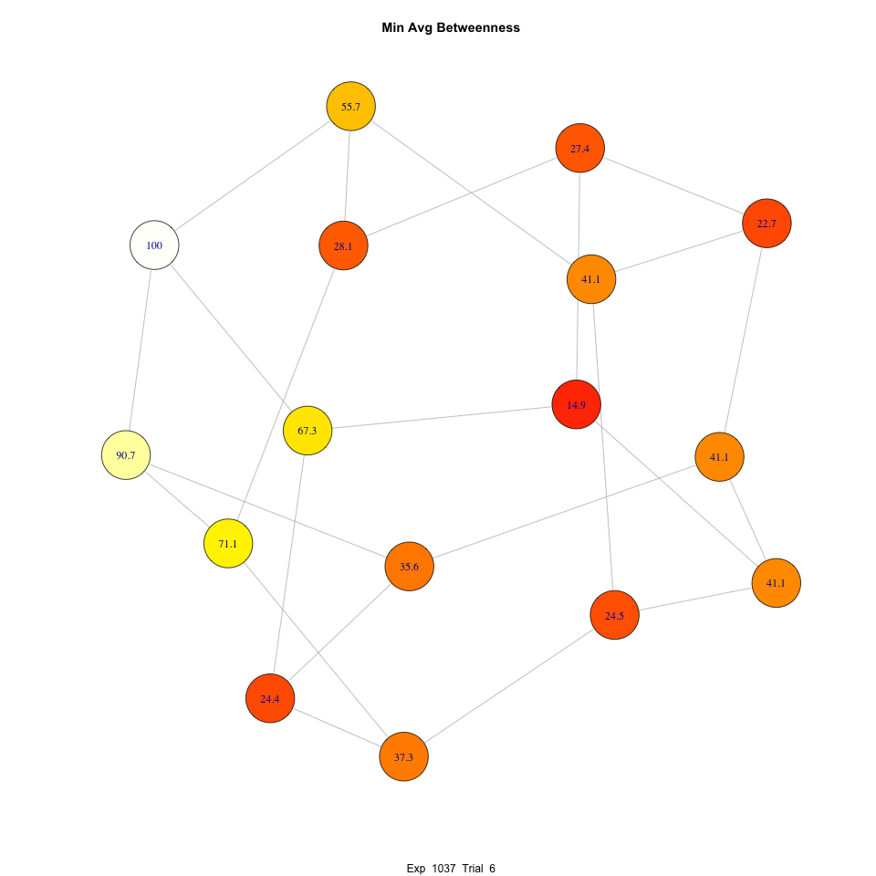
Diffusion of Best Solution

Slide 46
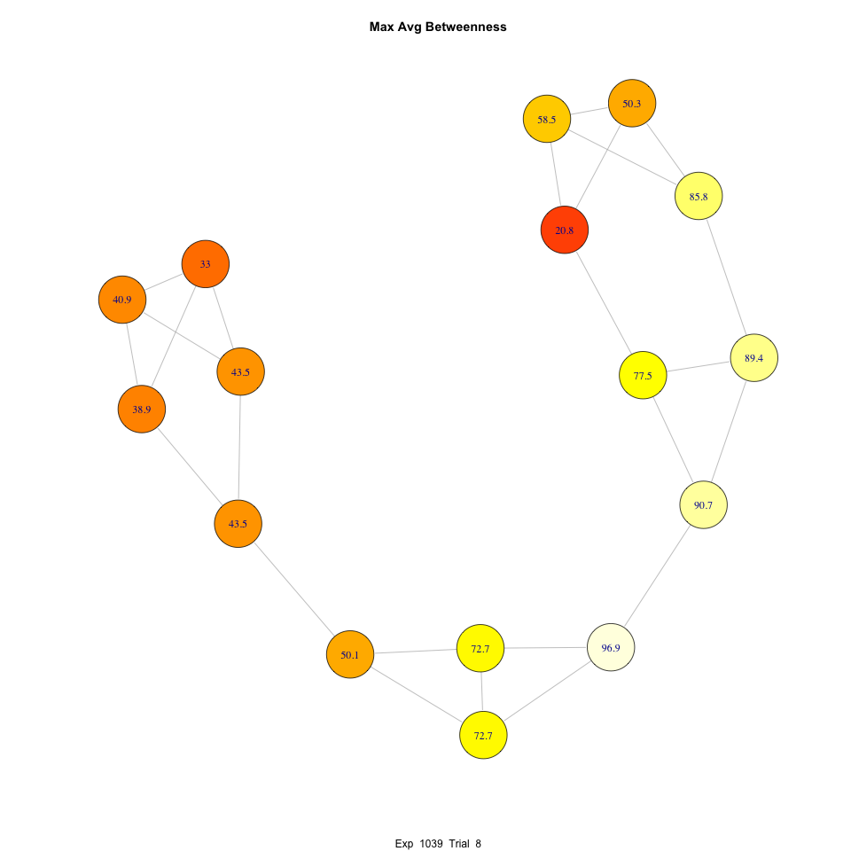
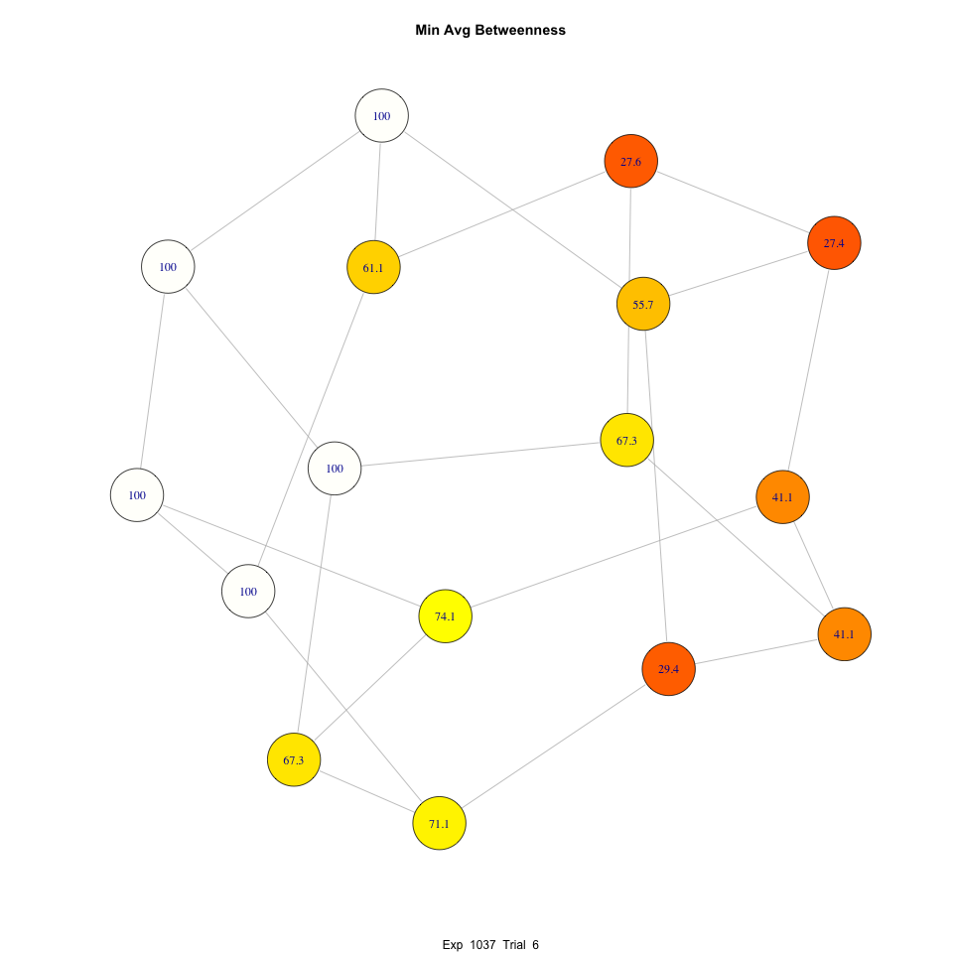
Diffusion of Best Solution

Slide 47
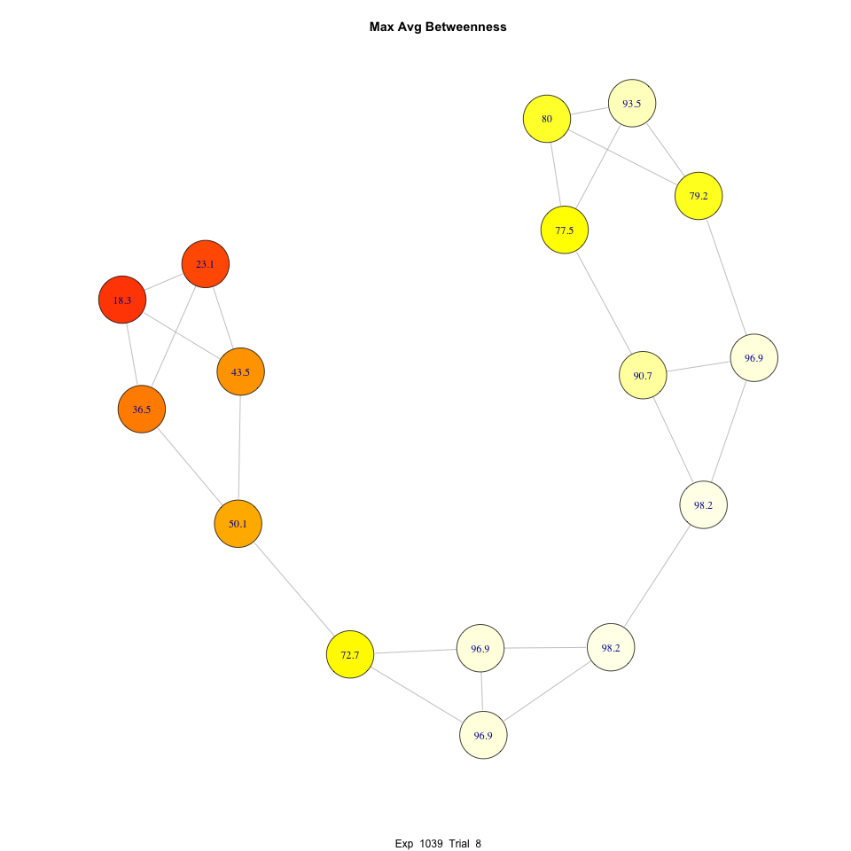
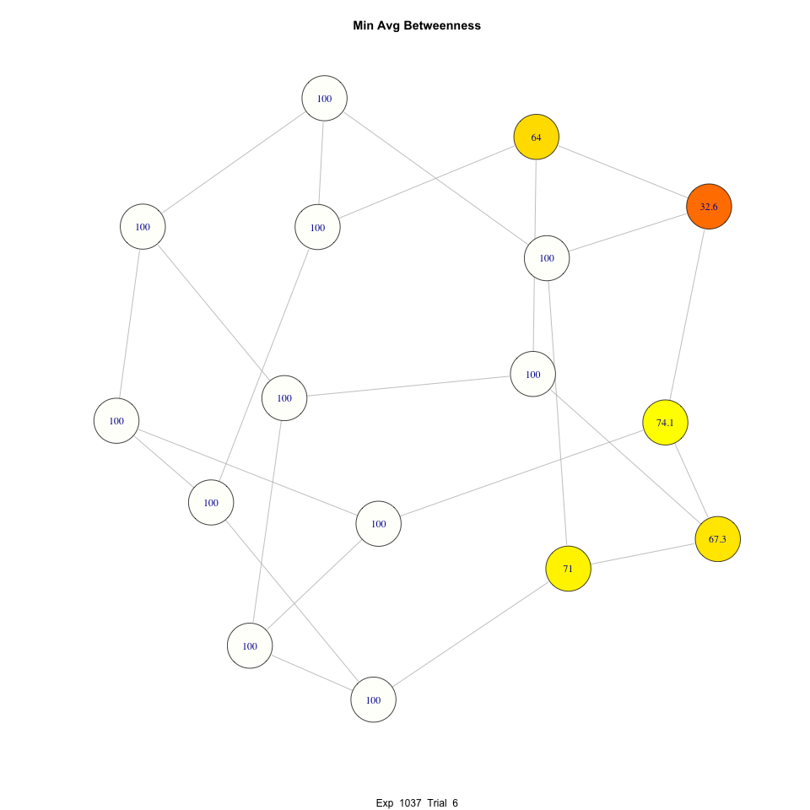
Diffusion of Best Solution

Slide 48
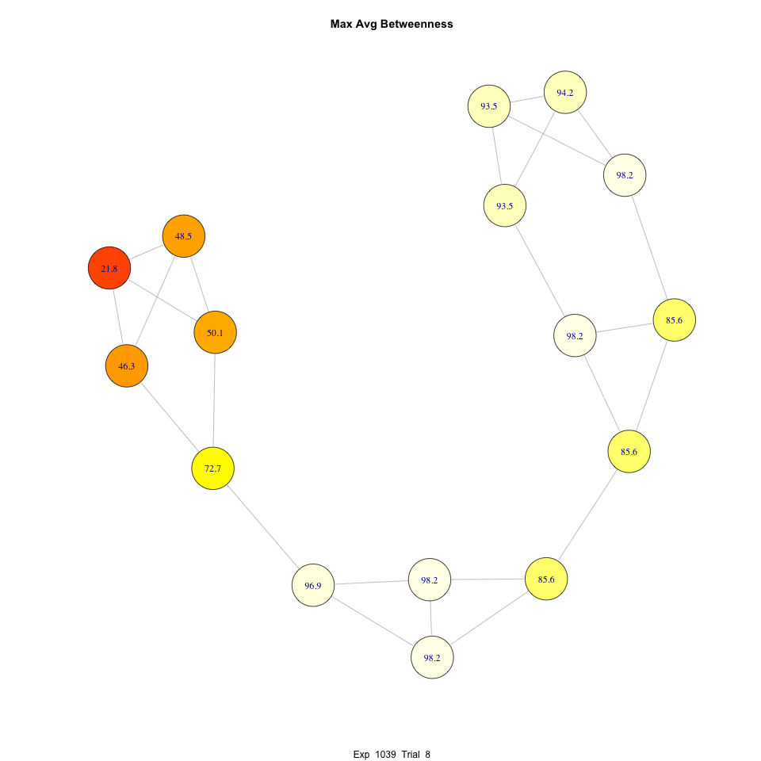
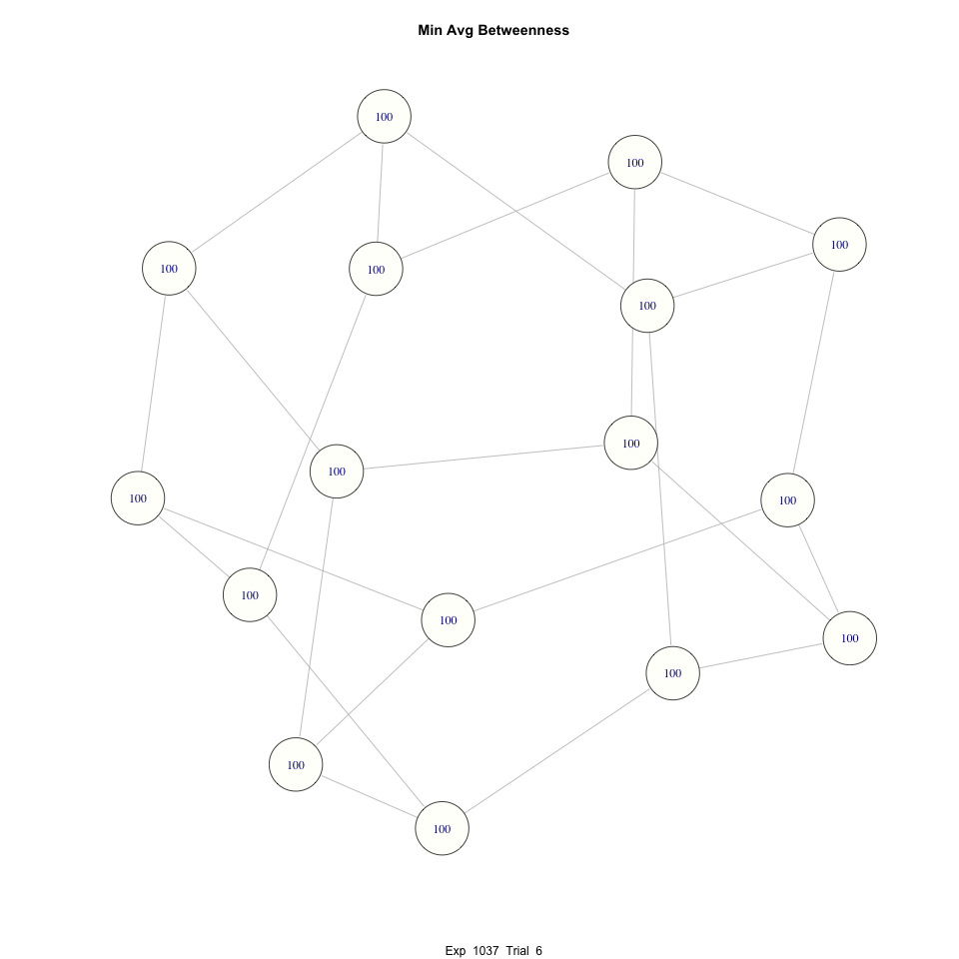
Diffusion of Best Solution

Slide 49
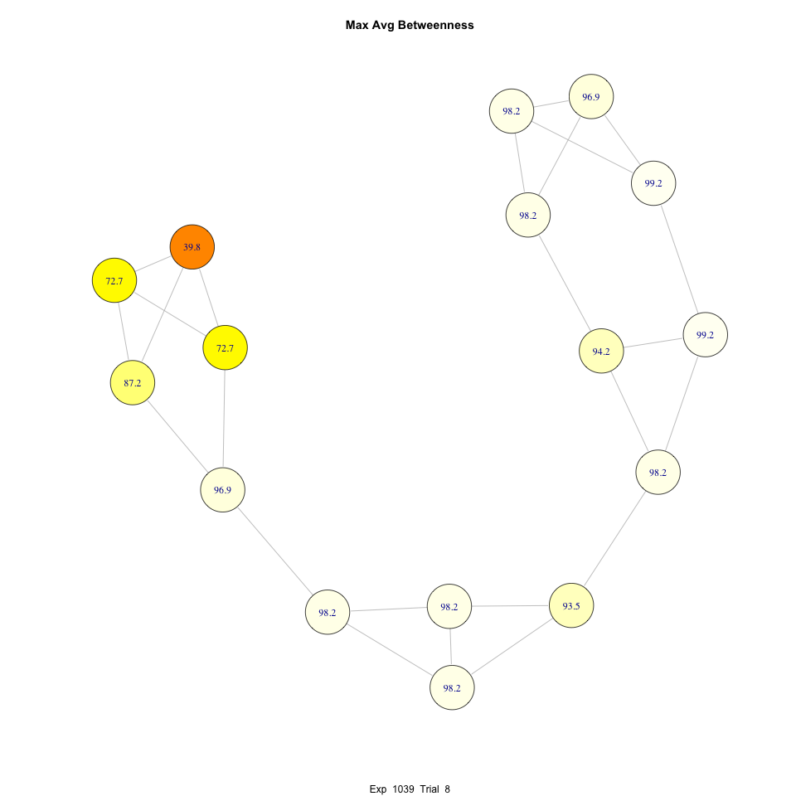
Diffusion of Best Solution

Slide 50
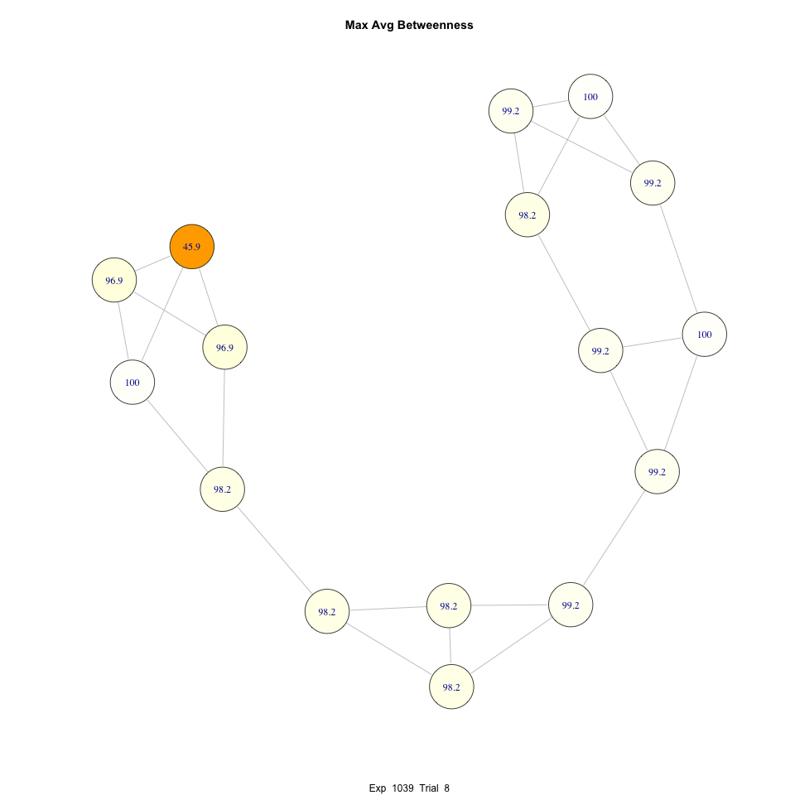
Diffusion of Best Solution

Slide 51
Networks Affect Convergence Time
Faster convergence is apparent

Slide 52
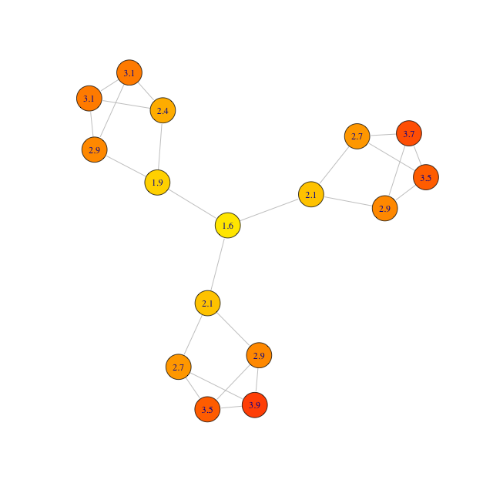
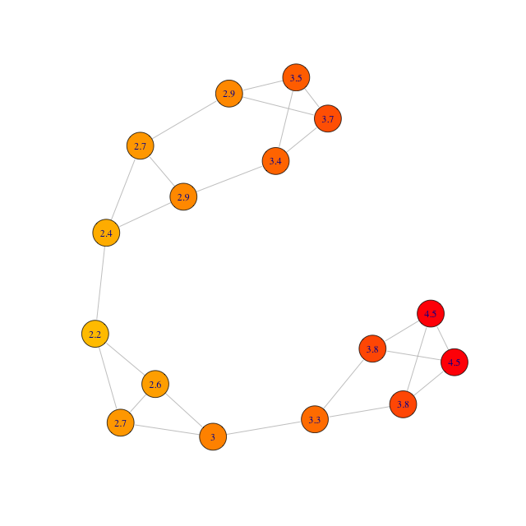
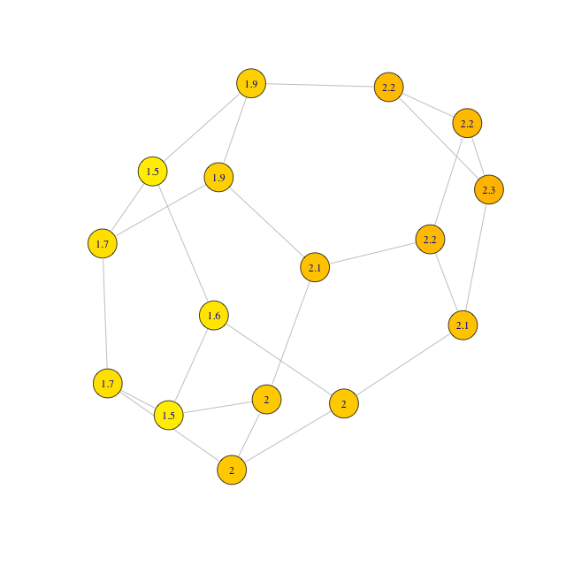
Individual Performance Is Combination of Individual Position and Collective Performance
Greatest Maximum Betweenness
Greatest Average Betweenness
Greatest Maximum Closeness
Individuals in centralized networks perform well, relative to their peers
All individuals in centralized networks perform poorly relative to individuals in decentralized networks

Slide 53
For Individual Performance: Clustering and Constraint = Bad Betweeness and Closeness = Good
All graph features highly correlated
Each feature fit separately with multi-level model
Black line is overall fit
Colored lines are best fits for each network topology
Effects of structural position vary with network, except for closeness

Slide 54
What Strategy are Players Using?
Players have information about
Their own past locations and scores
Their neighbors’ past locations and scores
Players can therefore choose between
Copying a past location and score (exploit)
Exploring more or less locally
How does this choice depend on
Time elapsed?
Highest score witnessed?

Slide 55
Strategy Depends on Overall Success and Time Elapsed

Slide 56
Strategy Doesn’t Depend Significantly on Network or Position
Players are unaware of structure of graph or position in graph
Therefore no explicit adaptation of strategy to graph or position

Slide 57
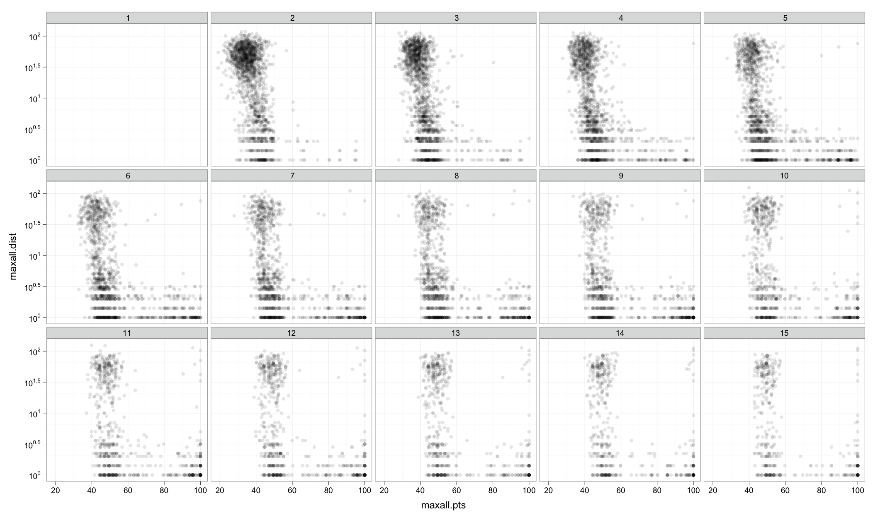
Exploration vs. Exploitation

Slide 58
Individually, Copying and Success are Positively Correlated

Slide 59
For the Group, Copying and Points are Negatively Correlated

Slide 60
Conclusions
Network structure does not affect how quickly members find the best solution
Network structure does affect how quickly members converge on the solution, and therefore the success of the group
Position in the network affects individual success, but not as much as network as a whole
Individuals in centralized networks perform well, relative to their peers
All individuals in centralized networks perform poorly relative to individuals in decentralized networks
Players may have a social dilemma
Explore and increase benefit to group
Exploit and increase benefit to self

Slide 61
Thank you!
Mason & Suri (under review). Conducting behavioral research on Amazon’s Mechanical Turk. http://ssrn.com/abstract=1691163
Suri & Watts (in preparation). A study of cooperation and contagion in networked public goods experiments.
Mason & Watts (in preparation). Collaborative problem solving in networks.

Slide 62
Statistical Properties of Networks
62
 | Clustering Coefficient | Average Path Length | Diameter | Connected Comps.
Cliques | 1.00 | 1 | ∞ | 4
Paired Cliques | 0.80 | 1.81 | ∞ | 2
Cycle | 0.60 | 2.54 | 5 | 1
Small World | 0.41 | 2.23 | 4 | 1
Random Reg. | 0.09 | 2.01 | 3 | 1
All Networks
24 nodes
60 edges
regular
degree 5
Notes:
C = \frac{1}{n} \sum_{v \in V} \frac{|\Delta \mbox{'s on v}|}{\binom{\deg(v)}{2}}
maybe only talk about clustering coefficient?
maybe cut the other columns

